Slide 1
UIC Digital developments On behalf of the Worldwide Railway Community

Slide 2
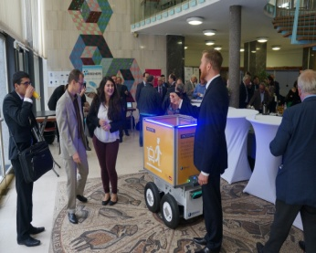
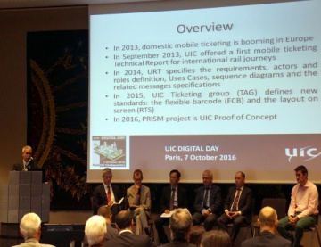
Digital revolution
In-depth society disruption induced by the digital techniques boom
Worldwide connection of people and things
Unique opportunity to go faster and further in progress
Railway can be an actor and a vector of development of the 21st century
Notes:
Digital revolution is a in-depth society disruption induced by the digital techniques boom. This major transformation leads to a worldwide connection of people and things.
The 3rd industrial revolution, the digital one, must be for Rail operators and manufacturers the unique opportunity to go faster and further in progress, enabling Railways in the world to once again be an actor and a vector of development of the 21st century.

Slide 3
Railway trends
Cybersecurity
Intermodal transport solutions
Interoperability
Automation and safety
Location Based Services
Drones
Digitization of payments
Climate change
Big data
Smart cities
High-Speed and Hyper-Speed Rail
3D printing
Notes:
Cybersecurity
Intermodal transport solutions
Interoperability
Automation and safety
Location Based Services: with use of real-time data to send highly targeted adverts to passengers
Drones: use for infrastructure inspection and maintenance
Digitisation of payments
Climate Change: impact on rail design, operation and maintenance
Big data
Smart cities
High-Speed and Hyper-Speed Rail
3D printing: revolution of supply chain (manufacturing, transportation and storage)

Slide 4
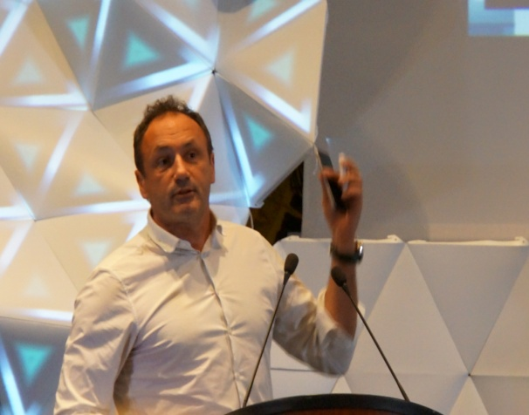
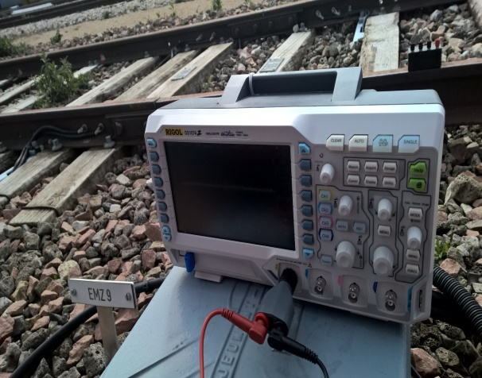
Data management
Organization of mobility make it very difficult to conceive a high capacity rail system based on quick (quasi realtime) dispatch.
But managing the data is the key
Notes:
Managing the data is THE key !
In an environment moving towards real-time, organization
of mobility (from demand and supply sides),
physics of Railways impose serious constraints to
accompany.
How could Railways ride this wave?
The physics of railways make it very difficult to conceive
a high capacity rail system based on quick (quasi real
time) dispatch.

Slide 5
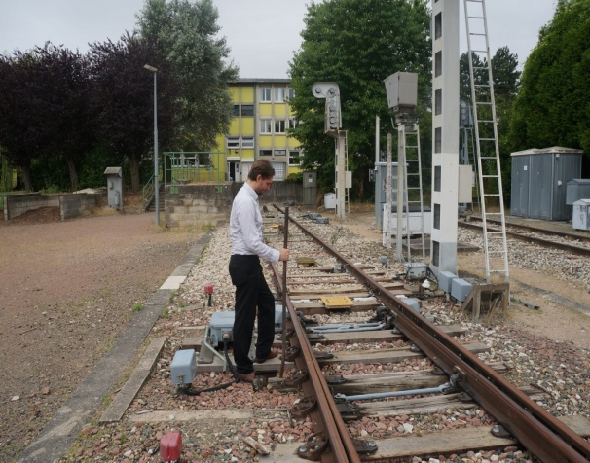
Digital for a better intermodal mix of transports
Railways must be a reliable trunk, stimulating customised link to other more flexible modes
Quick deployment of alternative services in case of disruption, with individual notification
Needs of better coherence and synergy in terms of:
Physical interface
Management of space and schedules
Logistics
National networks’ harmonization and cooperation
Hubs optimization
New information and communication technologies implementation
Notes:
Intermodal transport is crucial for new mobility services by ensuring their efficiency, attractiveness and economic optimization.
In a real-time age, Railways must be a reliable trunk, stimulating customised links to other more flexible modes. Ensuring quick deployment of alternative/complementary services in case of disruption, preferably with individual notification of each passenger about her/his new path.
Needs of better coherence and synergy:
Physical interface
Management of space and schedules
Logistics
National networks’ harmonization and cooperation
Hubs optimization
New information and communication technologies implementation

Slide 6
Cybersecurity
Risk of losing control of:
the operational aspect of the trains
the increasingly large data (technical, passenger, financial)
Attack surface extended:
Internet of Things
Convergence of IT and Operation Technology
Increasing use of networked control and automation systems
Obligations to protect the safety of operations (EU and domestic laws)
Notes:
2 vulnerabilities for railway: losing control of the operational aspect of the trains and of the increasingly large data (technical, passenger, financial)
Connected interdependence introduces new vulnerabilities to railway infrastructure, historically isolated from cyber attacks
Attack surface has dramatically extended:
Internet of Things
Convergence of IT and Operation Technology
Increasing use of networked control and automation systems
Rail operators have obligations under EU and domestic law to protect the safety of their operations

Slide 7
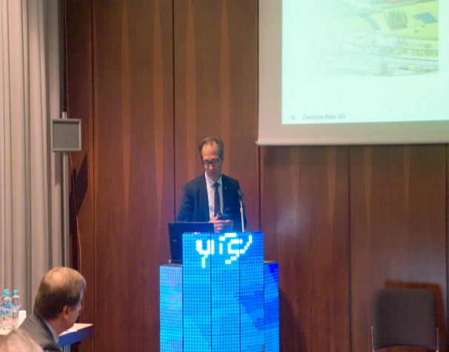
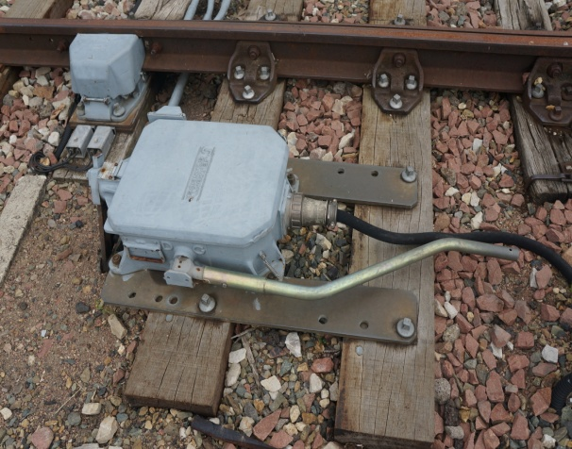
For better quality of operating services
Connected objects need to be "secure by design"
Act to educate users and invest in safety and security
Industry 4.0
Crowd sourcing of engineering
Big data
Personalized suggestions
IoT – Internet of things
Real-time tracking
Industry 4.0
Predictive maintenance
Build tracks & infrastructure
Manufacture rolling stock
Marketing & sales
Operate network & logistics
Customer service
Maintenance
Autonomous driving
Driverless trains
Big data
Improved forecast accuracy
Big data
Increased productivity
IoT
Condition monitoring systems
Cyber security
Data confidentiality & network safety
Notes:
Connected objects, if not "secure by design", promise a catastrophe that Human Community would struggle to recover.
It is time to act to educate users and invest in safety and security, so that our interconnected world remains a space of culture and progress.

Slide 8
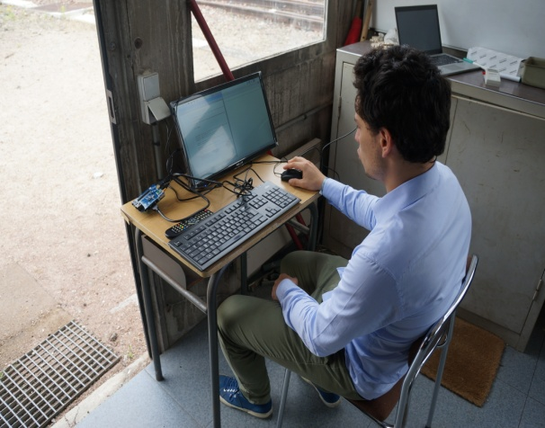
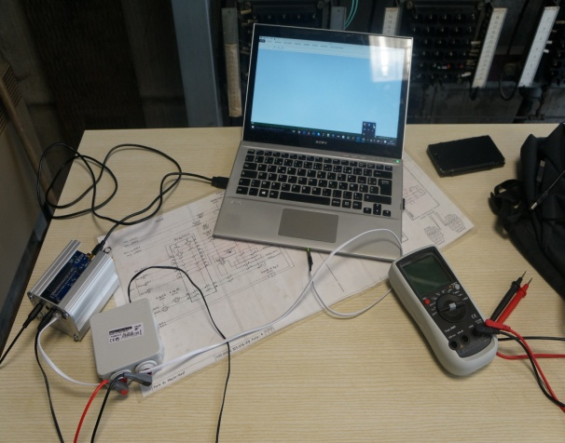
For better quality of customer services
Digital with impacts along all service and customer value chain:
Digital services
Get travel inspiration
Big data
Personalized travel suggestions
Digital services
Single platform for planning
Cyber security
Guaranteed data confidentiality
Digital services
Share experience online
Contact
Inspiration/
desire to travel
Planning/ booking
Physical travel chain
After the trip
Share
Digitization of payments
Paperless train tickets
Autonomous driving
Door-to-door
Connectivity
Stay connected all the journey
Digital services
Apps to navigate on-board and order food

Slide 9
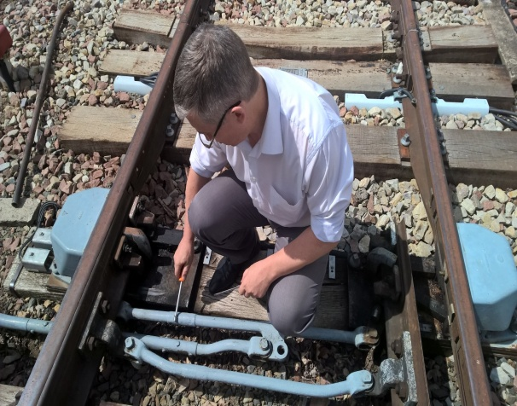
UIC Digital Platform
Digital Platform aims at supporting UIC members’ digital strategy and activities.
Facilitate interactions between railway and the digital eco-system
POC: Easy and quick validation by testing of a concept, to solve an operational issue with new digital resources (realized in 2016) :
Detection of shunting default
Detection of broken rail
Analysis of switch motor performance
Notes:
Created in November 2015, the Digital Platform aims at supporting UIC members’ digital strategy and activities.
Our ambition is to facilitate interactions between two worlds: railway and the digital eco-system.
Railways can better share information, open services and connect people at the service of humanity.
This platform will foster innovation, help Members activate their projects and their contacts
with the digital community.

Slide 10
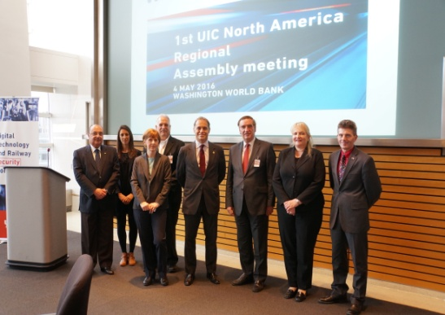
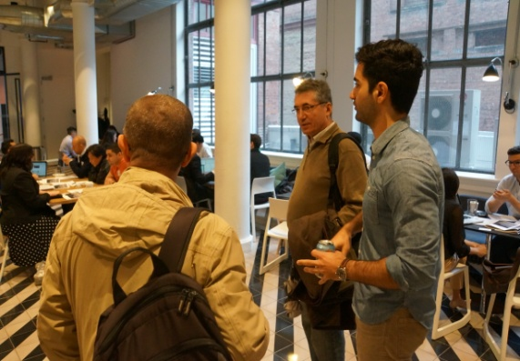
UIC Digital Platform
Share information & best practices amongst members
Open
Connect
Share
Open projects for
members
Connect startups to
members

Slide 11
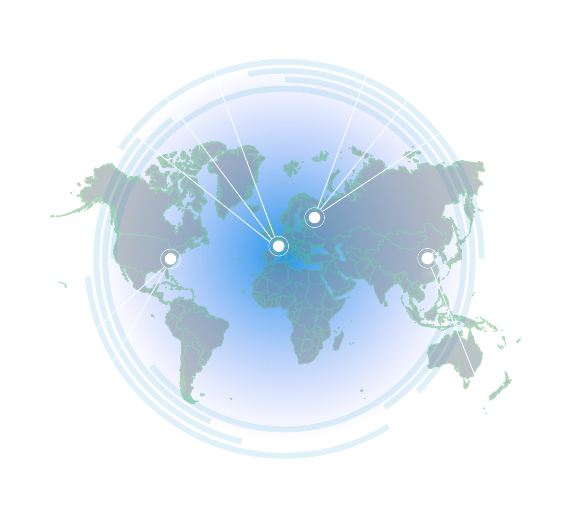
Digital Day with Freight and Passengers workshops, Paris (November)
2016/2017 Roadmap
2nd UIC Digital Conference, Saint Petersburg (November)
1st Digital Awards, Saint Petersburg (December)
3rd UIC Digital Conference, Paris (December 2017)
2nd edition of Progress Paper, Saint Petersburg (December)
2nd UIC Digital Awards, Paris (December 2017)
Digital Technology and Railway Security workshop, Washington (May)
1st edition of UIC Progress Paper, Washington (May)
IoT and Big Data workshop, Beijing (March 2017)

